Slide 1

Module 7
Abstraction and Console App Classes

Slide 2
Learning Objectives
Develop abstractions for a variety of problems
Design a class to use in console applications
Implement the fields and properties in a console application class
Implement the constructors for a console application class
Implement the methods in a console application class

Slide 3
Content (slot 1)
High-level Class Design
Exercise 25: What is an Apple?
Exercise 26: Gravity, It's Just a Theory
Implementing Classes in C#: Fields
Exercise 27: A Classy Apple
Implementing Classes in C#: Properties
Exercise 28: Apple Fields and Properties
Implementing Classes in C#: Constructors and Other Methods
Exercise 29: Building an Apple
Exercise 30: Eating an Apple

Slide 4
7.1 High-level Class Design
Our main goal in this section is to create a UML class diagram for the class we’re trying to design.
As we develop more of our own classes, we’ll use this process during the Design a Solution step in our problem-solving process.
Problem description:
Design and implement a class for a deck of cards. The class should implement standard operations that we perform on a card deck.

Slide 5
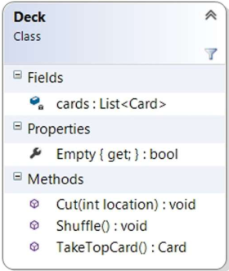
7.1 High-level Class Design
Deck UML Diagram

Slide 6
Exercise 25: What is an Apple?
View in LMS

Slide 7
Exercise 26: Gravity, It's Just a Theory
View in LMS

Slide 8
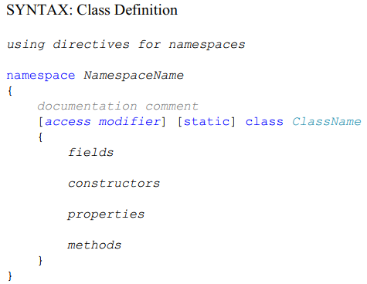
7.2 Implementing Classes in C#: Fields

Slide 9

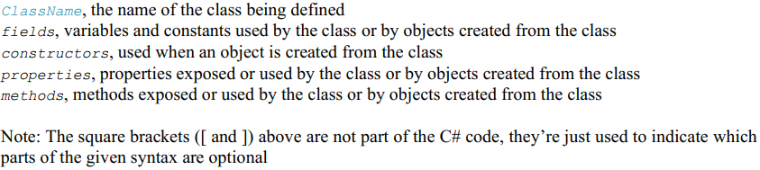
7.2 Implementing Classes in C#: Fields

Slide 10
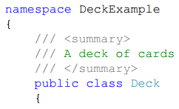
7.2 Implementing Classes in C#: Fields
Example: define Deck class

Slide 11
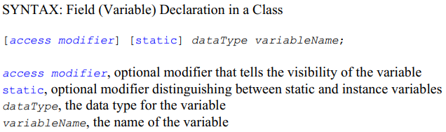
7.2 Implementing Classes in C#: Fields
A private variable is one that can only be looked at and modified by properties and methods contained in the class that declares the variable.
Making our variables private helps us keep our variables hidden inside our objects so that objects can only interact with one another through the object properties and methods.
Because making our variable private is such a good idea, if we don’t provide an access modifier at all the default for the variable in a class is private, so you only need to add an access modifier if you want something other than private for that variable.
Making the (private by default) fields in our Unity scripts visible in the Inspector by marking them with [SerializeField]

Slide 12
7.2 Implementing Classes in C#: Fields
Public fields can be accessed directly by methods and objects outside the class; we’ll try to avoid public variables like the plague, but public constants are fine because consumers of the class can’t mess them up.
Protected fields can be accessed within the class and by subclasses of this class (when we want to use inheritance, which we’ll discuss later in the book); we’ll only use protected fields if we’re using inheritance in our problem solution.
The two access modifiers, internal and protected internal, won’t be required for the problems we solve in this book (nor do we use them in any of the commercial games we develop).

Slide 13
7.2 Implementing Classes in C#: Fields
A static variable is a single variable that gets “shared” by every object that’s been created for that class.
Say we want to give each deck of cards a unique ID. Not only is this a classic example for static variables, we’ve actually had this precise need in one of our commercial games for our game objects. The highest ID that’s been used so far isn’t information that really belongs in one particular object of the class; it’s really class-wide information, since it applies to all objects of that class.
If we use a static variable, we can assign each new deck object a unique ID when we create it (that ID would be stored in an instance variable for the new object), then increment the static variable to make sure the next deck object we create gets a different ID.

Slide 14
Exercise 27: A Classy Apple
View in LMS

Slide 15
7.3 Implementing Classes in C#: Properties
Properties are typically used to provide access to the fields in the class; in other words, to provide access to the state of the object.
The three kinds of access we can provide for a property are read access, write access, and read-write access.
read a property using a get accessor.
write a property using a set accessor.
to allow both read and write access (typically called read-write access) to the property, provide both get and set accessors for the property.

Slide 16
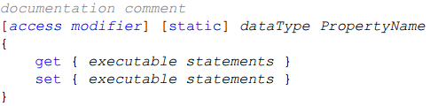
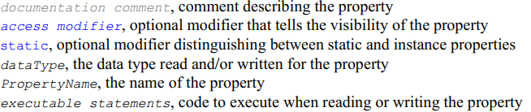
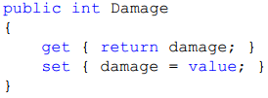
7.3 Implementing Classes in C#: Properties
Example:

Slide 17
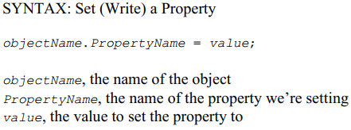
7.3 Implementing Classes in C#: Properties
Example:

Slide 18
7.3 Implementing Classes in C#: Properties
So why not just make our fields public instead of private – then we won’t need to use properties at all? There are several reasons:
First, when we make a field public, any consumer of the class can both read and write the field. That might be fine in some cases, but in other cases (like the Empty property in our Deck class) we don’t want to let them both read and write. It’s therefore better – and easier – to always make our fields private and provide the properties necessary to let consumers access them as appropriate.
Second, we can provide error-checking in the set accessor to make sure the consumer setting the property isn’t setting it to an invalid value.

Slide 19
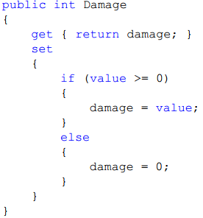
7.3 Implementing Classes in C#: Properties
Example: we can change our Damage property to make sure we clamp the property to 0 if the consumer tries to set the Damage property to a negative number.

Slide 20
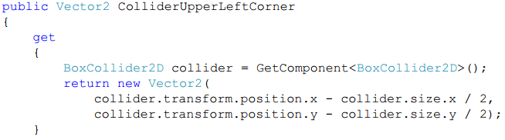
7.3 Implementing Classes in C#: Properties
Finally, we can expose properties that are intuitive to the consumer of the class but require a little extra processing “under the hood.”
Example: we wanted to provide the upper left corner of the collider for a TeddyBear object.

Slide 21
Exercise 28: Apple Fields and Properties
View in LMS

Slide 22
7.4 Implementing Classes in C#: Constructors and Other Methods
Constructors are used to create new objects, where each object has its own identity.
Methods implement the behavior of the object.

Slide 23
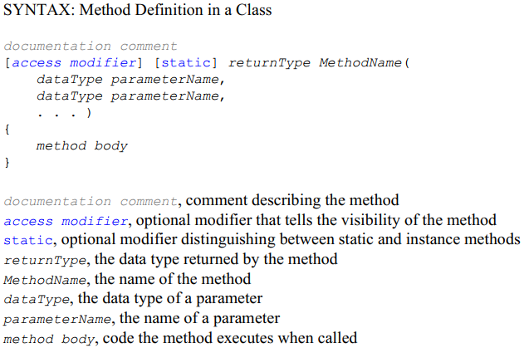
7.4 Implementing Classes in C#: Constructors and Other Methods

Slide 24
7.4 Implementing Classes in C#: Constructors and Other Methods
The first part of the method (the part starting with the access modifier and ending just before the open curly brace) is called the method header. Let’s take a closer look.
The access modifier for a method works exactly the same way as an access modifier for the fields and properties in the class; we choose between public, protected, private, internal, and protected internal to determine who can see and use this method.

Slide 25
7.4 Implementing Classes in C#: Constructors and Other Methods
The next thing we need to decide for our methods is whether we want them to be static methods or instance methods; this is the same idea as static variables and instance variables.
If we decide that the method is an instance method – the most common kind in this book and the most common kind you’ll use in general – then each object will have its own copy of this method.
If we decide that a method is a static method, we include the word static in our method declaration. One quick caution – static methods are NOT allowed to access instance variables.
The third thing we see in the method header is the return type for the method. This tells us which data type will be returned by the method.
Next, we pick our method name, which should be descriptive (just like our field and property names). The final part we need to worry about in the method header is the list of parameters for this method.

Slide 26
7.4 Implementing Classes in C#: Constructors and Other Methods
Finally, we include the method body, the part of the method that does the actual work for the method when the method is called.
The method body contains any local variables we need in the method. When we have variables or constants that we only need in a particular method, we declare those variables and constants at the beginning of the method body. These are called local variables (and constants) because they can only be used inside the method in which they’re declared.
There are two kinds of methods in the classes you define: constructors and all the other methods you need.

Slide 27
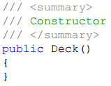
7.4 Implementing Classes in C#: Constructors and Other Methods
Constructors are used when you create a new object from this class; whenever we’ve created objects in our programs up to this point, we’ve been using the constructor to do so.
Example: create a constructor for the Deck class.
The constructor doesn’t do anything other than create the object.

Slide 28
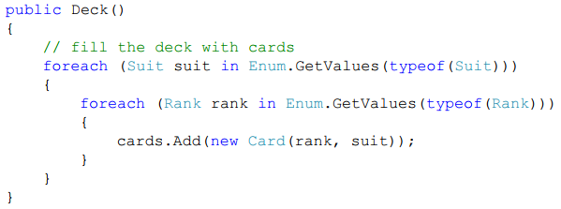
7.4 Implementing Classes in C#: Constructors and Other Methods

Slide 29
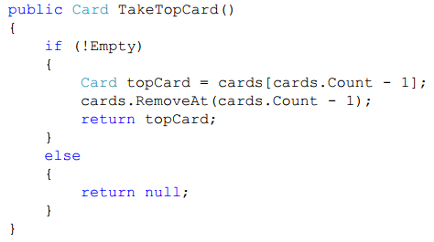
7.4 Implementing Classes in C#: Constructors and Other Methods
Implement TakeTopCard method

Slide 30

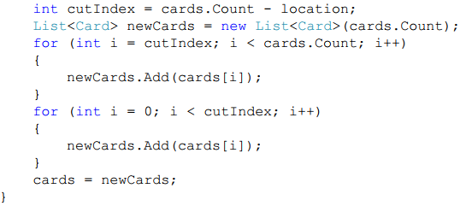
7.4 Implementing Classes in C#: Constructors and Other Methods
Implement Cut method

Slide 31
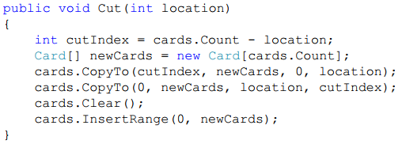
7.4 Implementing Classes in C#: Constructors and Other Methods
Revised Cut method (use the List class)

Slide 32
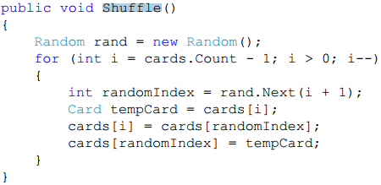
7.4 Implementing Classes in C#: Constructors and Other Methods
Implement Shuffle method

Slide 33
Exercise 29: Building an Apple
View in LMS

Slide 34
Exercise 30: Eating an Apple
View in LMS

